Slide 1
Analytical instrumentation Section-2, Ppt-26

Slide 2
. Paper chromatography
Paper chromatography is a separation technique where the separation is performed on a specialized paper.

Slide 3
Uses of Paper chromatography
Paper chromatography is performed to detect the purity of various pharmaceutical products.
It can also be employed to detect contamination in various samples, like food and beverages.
This method can also be used for the separation of impurities from various industrial products.

Slide 4
Paper Chromatography Principle
The principle involved can be partition chromatography or adsorption chromatography.
Partition chromatography because the substances are partitioned or distributed between liquid phases.
The two phases are water held in pores of the filter paper and the other phase is a mobile phase which passes through the paper. When the mobile phase moves, the separation of the mixture takes place.
The compounds in the mixture separate themselves based on the differences in their affinity towards stationary and mobile phase solvents under the capillary action of pores in the paper.

Slide 5
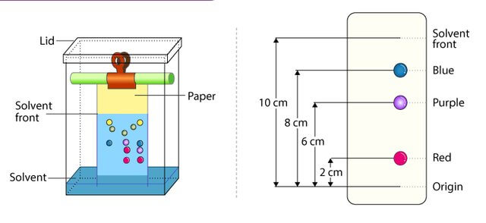

Slide 6
Selecting a suitable filter paper: Selection of filter paper is done based on the size of the pores, and the sample quality.
Prepare the sample: Sample preparation includes the dissolution of the sample in a suitable solvent (inert with the sample under analysis) used in making the mobile phase.
Spot the sample on the paper: Samples should be spotted at a proper position on the paper by using a capillary tube.
Chromatogram development: Chromatogram development is spotted by immersing the paper in the mobile phase. Due to the capillary action of paper, the mobile phase moves over the sample on the paper.
Paper drying and compound detection: Once the chromatogram is developed, the paper is dried using an air drier. Also, detecting solution can be sprayed on the chromatogram developed paper and dried to identify the sample chromatogram spots.

Slide 7
Types of paper chromatography:
Ascending Paper Chromatography – The techniques goes with its name as the solvent moves in an upward direction.
Descending Paper Chromatography – The movement of the flow of solvent due to gravitational pull is downwards hence the name descending paper chromatography.

Slide 8
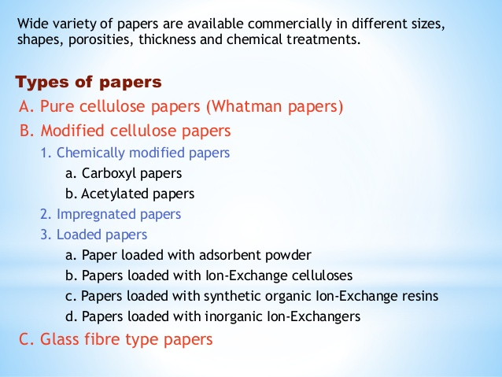

Slide 9
MASS SPECTROMETER
Mass spectrometry is an analytical tool useful for measuring the mass-to-charge ratio (m/z) of one or more molecules present in a sample.

Slide 10
Application
Food contamination detection,
Pesticide residue analysis,
Isotope ratio determination,
Protein identification.

Slide 11
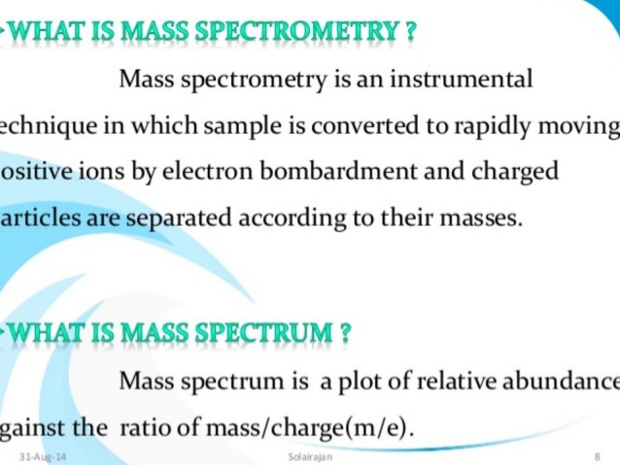

Slide 12
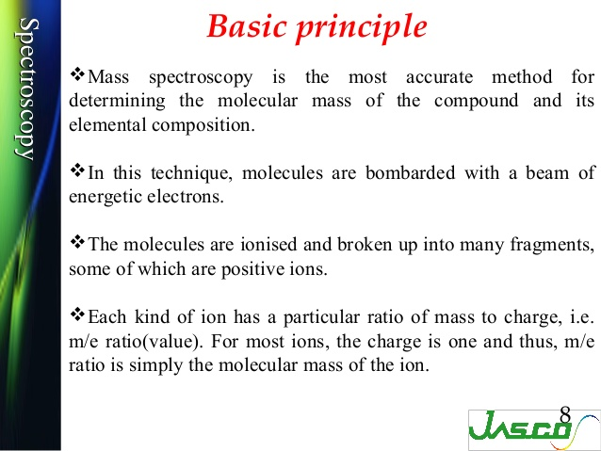

Slide 13
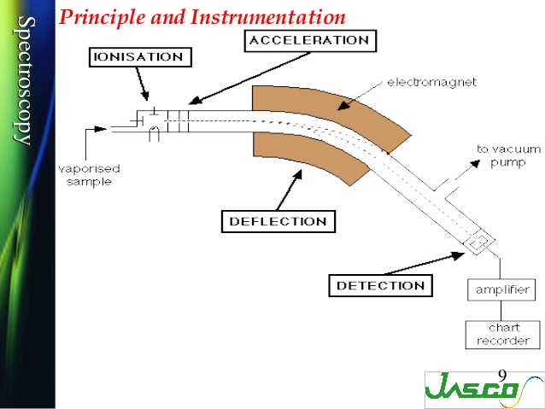

Slide 14
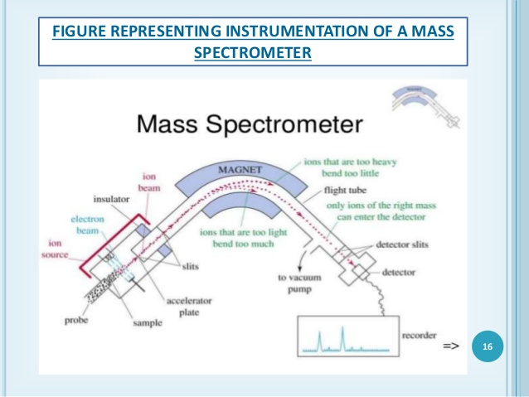

Slide 15
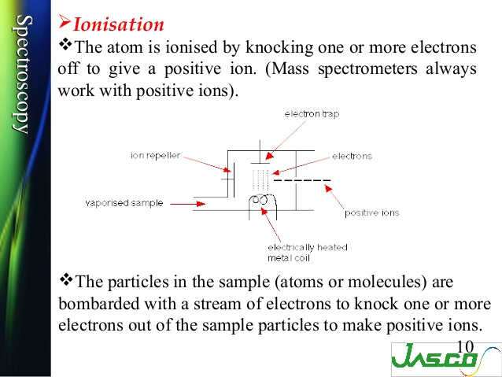

Slide 16
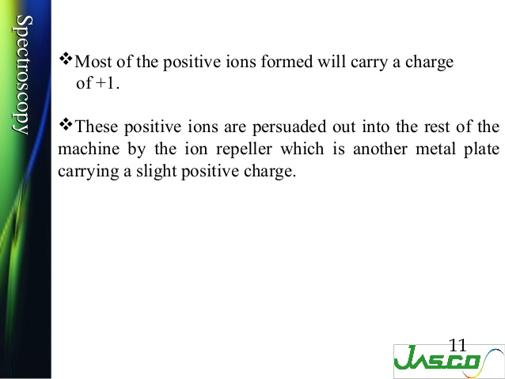

Slide 17
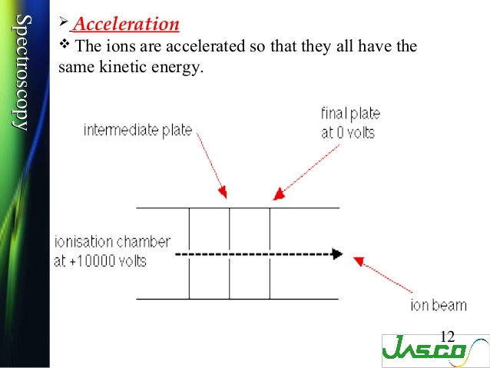

Slide 18
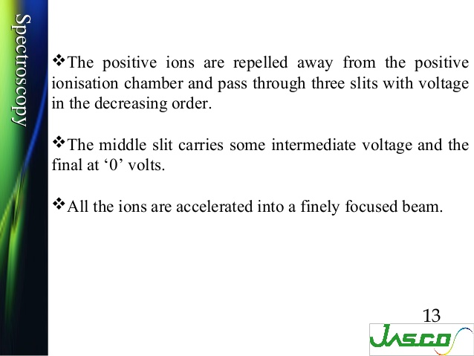

Slide 19
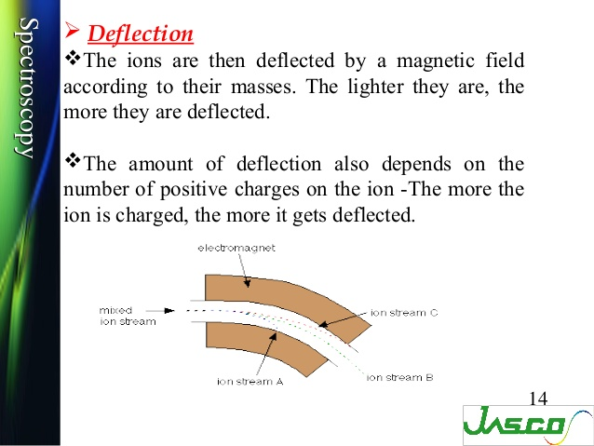

Slide 20
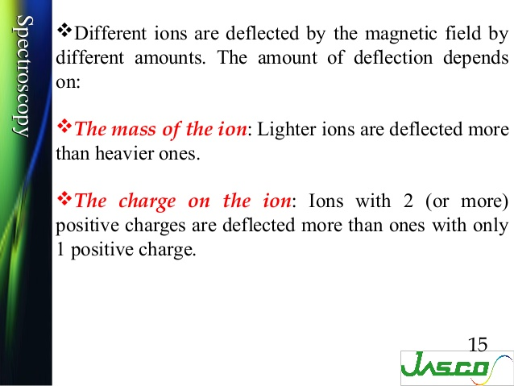

Slide 21
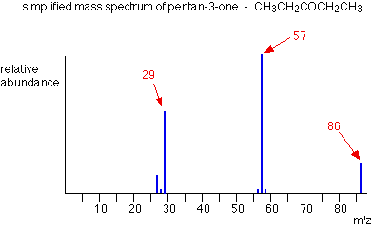
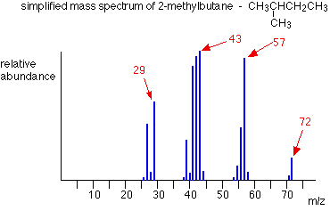

Slide 22
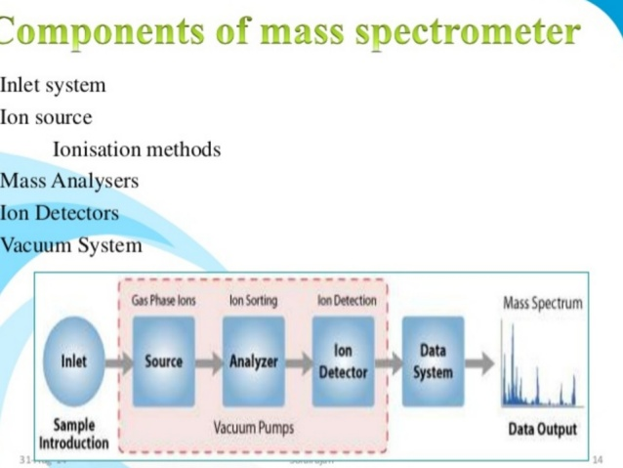

Slide 23
Thank you

